Slide 1
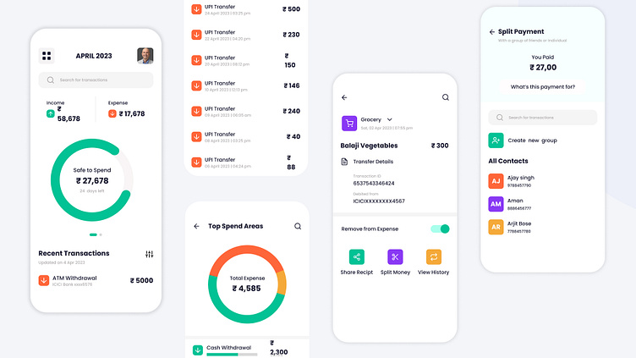
Full-Stack Web Development Project
Personal
Expense
Tracker
A Web-Based Solution for Personal Financial Management
Transforming Financial Chaos into Clarity
Project Team
Devansh Agrawal • Govind Rana • Gagan Saraswat
Project Supervisor
Sanskar Geda • Abhinav Gupta
Mr. Samarth Vohra

Slide 2
Problem Analysis
Financial Chaos in Daily Life
No Proper Records
Poor Money Management
Most individuals, especially students, do not maintain proper financial records. Expenses are usually remembered mentally or written in notebooks.
Without tracking, users cannot calculate monthly expenses, identify unnecessary spending, or manage savings effectively.
Mental tracking only
No documentation
Complex Solutions
Manual Tracking Limits
Existing financial software is often complex and designed for businesses, not individuals who need simple, user-friendly solutions.
Records easily lost or damaged
No automatic calculation of totals
No analysis of spending habits
The Result
Difficult to maintain monthly reports
Users are unable to identify where their money is being spent and cannot control unnecessary expenses.

Slide 3
Project Definition
Objectives & Scope
1
Record Daily Expenses
Project Scope
User registration and login
Enable users to easily log their daily transactions with details like amount, date, and category.
Add, edit, delete expense records
Expense categorization system
2
Secure Data Storage
Monthly expense reports
Store financial data securely in a database with user authentication and access control.
Charts and graphs visualization
Limitations
3
Generate Monthly Summaries
Not designed for companies
Automatically calculate and display monthly expense totals with breakdowns by category.
No online banking integration
No payment transfer system
No tax calculations
4
Visual Reports & Charts
Single user usage only
Provide graphical representations of spending habits using interactive charts and graphs.
Target Audience
Individual users, especially students and personal users who need a simple, user-friendly system for managing daily expenses.

Slide 4
Technical Architecture
Technology Stack & Methodology
Front-End
Back-End
Handles user interface and interaction
Handles processing and data storage
HTML5
PHP
Page structure and semantic markup
Server-side logic and business rules
CSS3
MySQL
Design, layout, and responsive styling
Relational database for secure storage
JavaScript
Chart.js
Form validation and interactive charts
Data visualization and graphical reports
Development Methods Used
User Authentication
CRUD Operations
Form Validation
Data Visualization
Secure login system
Create, Read, Update, Delete
Input verification
Interactive charts

Slide 5
Core Capabilities
System Features
User Management
Expense Management
Monthly Reports
Registration
Add Expense
Automatic total calculations
New users can create accounts with secure credentials and profile information.
Record new transactions
Category-wise breakdown
Edit Record
Date range filtering
Modify existing entries
Export capabilities
Login System
Delete Entry
Secure authentication with password protection and session management.
Remove unwanted records
Charts & Graphs
View All
Browse complete history
Pie charts for category distribution
Bar charts for monthly comparison
Categorization
Line graphs for spending trends
Interactive and responsive
Food & Dining
Travel & Transport
Shopping
Bills & Utilities
Entertainment

Slide 6
System Architecture
Workflow & Process
1
User Registration & Login
System Layers
User creates an account with secure credentials and logs into the system with authentication.
User Interface
2
Enter Expense Details
HTML, CSS, JavaScript
User inputs transaction information including amount, date, category, and optional description.
Application Logic
3
Data Storage in Database
PHP Server
Expense data is securely stored in MySQL database with proper validation and sanitization.
Data Storage
4
MySQL Database
Edit or Delete Records
User can modify existing entries or remove unwanted records with confirmation prompts.
Security Measures
5
Automatic Calculations
Input validation
System automatically computes totals, category sums, and generates summary statistics.
SQL injection prevention
Secure session management
6
Generate Reports & Charts
Monthly reports and interactive charts are generated to visualize spending patterns and trends.

Slide 7
Technical Specifications
Hardware & Software Requirements
Hardware Requirements
Software Requirements
Computer/Laptop
Minimum 4 GB RAM for smooth operation
HTML5
CSS3
Structure
Styling
Input Devices
Keyboard and mouse for user interaction
JavaScript
PHP
Interactivity
Server Logic
Internet Connection
Required for web access and data synchronization
MySQL
XAMPP
Database
Server Stack
Development Tools
VS Code / Notepad++
Chart.js
Editor
Visualization
phpMyAdmin
Chrome / Edge
Database Management
Web Browser

Slide 8
Project Management
Development Timeline
6-Week Project Schedule
A structured development approach from planning to deployment
1
2
3
4
5
6
Planning
Database
Front-End
Back-End
Reports
Testing
Requirements gathering
Schema design
HTML/CSS development
PHP logic development
Chart integration
Bug fixes
MySQL setup
Report generation
System testing
System design
Table creation
JavaScript interactivity
API development
Data visualization
Deployment
Architecture planning
Database integration
Responsive design
Week 1
Week 2
Week 3
Week 4
Week 5
Week 6

Slide 9
Results & Roadmap
Expected Outcomes & Future Enhancements
Expected Deliverables
Future Enhancements
Fully Functional Web Application
Mobile App
Multi-User
A complete expense tracking system with all core features operational and tested.
Android application for on-the-go tracking
Support for multiple user accounts
Record Management System
Users can add, edit, delete, and view expense records with intuitive interface.
Budget Planning
Bank Integration
Set and track monthly budget goals
Automatic transaction import
Monthly Reports
Automated generation of detailed expense reports with category breakdowns.
Cloud Storage
Email Reminders
Remote database and backup
Bill payment notifications
Interactive Charts
Visual representation of spending patterns using pie charts, bar graphs, and line charts.
Data Backup
Notifications
Export and recovery options
Spending alerts and insights
Learning Outcome: This project demonstrates practical knowledge of web development, database management, and software design principles through a real-world application.

Slide 10
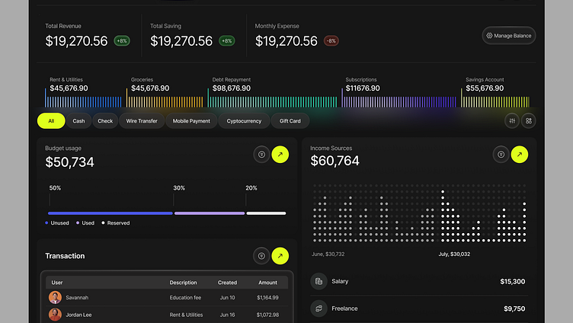
Transforming Financial
Chaos into Clarity
Digital Solution
Financial Discipline
Technical Excellence
Replaces manual record-keeping with an automated system that stores data securely and provides meaningful financial insights.
Helps users monitor spending habits, avoid overspending, and maintain better control over their personal finances.
Demonstrates practical implementation of front-end design, back-end programming, and database integration.
The Personal Expense Tracker Website provides a comprehensive solution for managing daily expenses, empowering users to take control of their financial future through technology.
Project Team
Project Supervisor
Devansh • Govind • Gagan • Sanskar • Abhinav
Mr. Samarth Vohra

